Slide 1
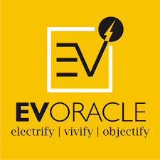
Barriers and Potential in Road to Electric Mobility
Northeast Electric Mobility Conclave
30 Oct 2019, Guwahati
Presented by
Dr. PARAG DIWAN
CEO, EVOracle

Slide 2
EV Outlook
Government of India want to see 6 million electric and hybrid vehicles on the roads by 2020 under the National Electric Mobility Mission Plan (NEMMP) 2020 and Faster Adoption and Manufacturing of Hybrid and Electric Vehicles (FAME).
The government has announced an outlay of ₹10,000 crore for FAME 2 to boost the number of electric vehicles in India.
₹1,000 crore has been earmarked for setting up charging stations for electric vehicles in India
Scheme has four focus areas, i.e. Technology development, Demand Creation, Pilot Projects and Charging Infrastructure.
India has around 4 lakh registered electric vehicles on road in August 2019 which are mainly 2- wheelers and 3-Wheelers in Tier I and II cities.

Slide 3

India EV Market Taxonomy
Type of EV Technology
PHEV
BEV
Type of Electric Vehicle
Passenger Car
Two-Wheelers
Type of End-User
Individuals
Commercial Enterprises
Government
Type of Charging Infrastructure
Normal Charging Station
Fast Charging Stations
Geography
North-East India
North India
South India
West India
East India
Three-Wheelers/E-Rickshaws
Commercial Vehicles
Public Transportation Vehicle

Slide 4
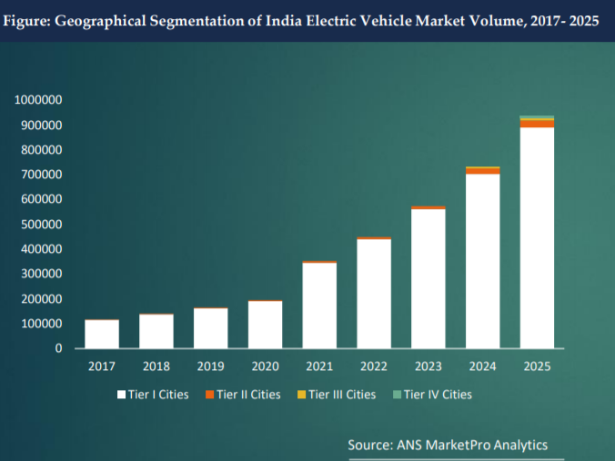
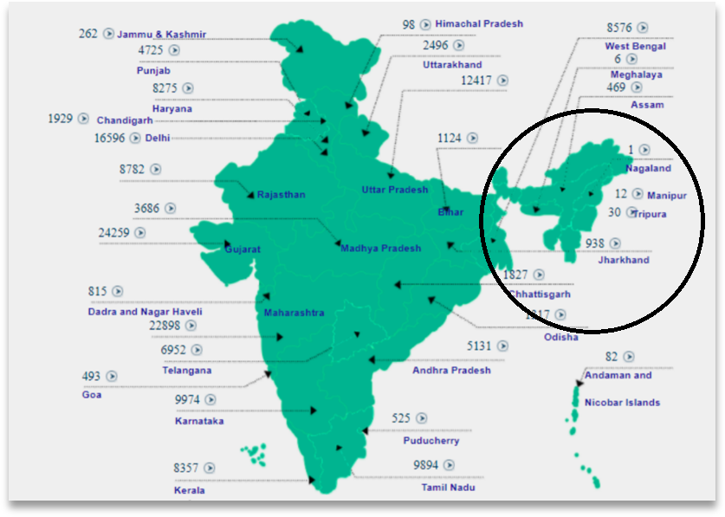
Geographical Segmentation

Slide 5
Macroeconomic Environment
Political
Stable Democratic Government
Policies favouring faster EV Adaptation
FAME II policy for EV promotion
Economic
Stable Economic Growth
Social
Pollution control
Technology
Development of indigenous technology
Legal
EV charging Standards
Environmental concerns
Emerging Technologies in batteries, charging equipment
Entrepreneurial eco system
Venture Funding for EV startups
EV battery Standards
Policy Frameworks
Social consciousness about green initiatives

Slide 6
Economic Consideration
One of the biggest challenges for adoption of electric vehicles in India is its price.
Generally 40% cost of the electric vehicle consist of battery which makes it more expensive than IC Vehicles.
Possible Solutions to this problem are:
Separation of Ownership of Battery from Vehicle
TCO Model being offered by manufacturers.
Battery Swapping

Slide 7
Separation of Ownership of Battery from Vehicle
Basis of this model :
  The batteries of vehicle could be purchased/leased separately from 3rd party providers or OEMs.
  Batteries could be purchased according to the range requirements which helps potential buyer to get cost optimal configuration.
  Standardised batteries with condition monitoring inbuilt using IoT.

Slide 8
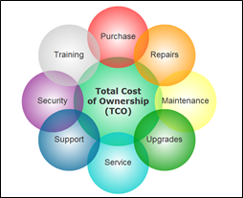
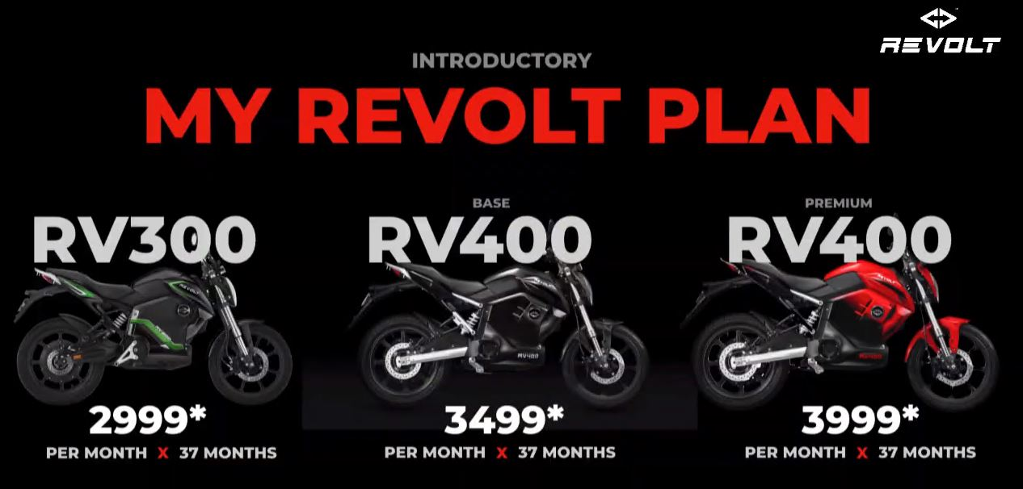
Total Cost Ownership Model
Under this model the consumer only needs to pay a certain amount of money to the company and it will include most costs i.e. Cost of Vehicle and cost of maintenance in future.
This model could be adopted after doing Cost-benefit analysis.
Eg. of Revolt Motors latest e-bikes.
Eg. Electric public bus model is also based on TCO.

Slide 9
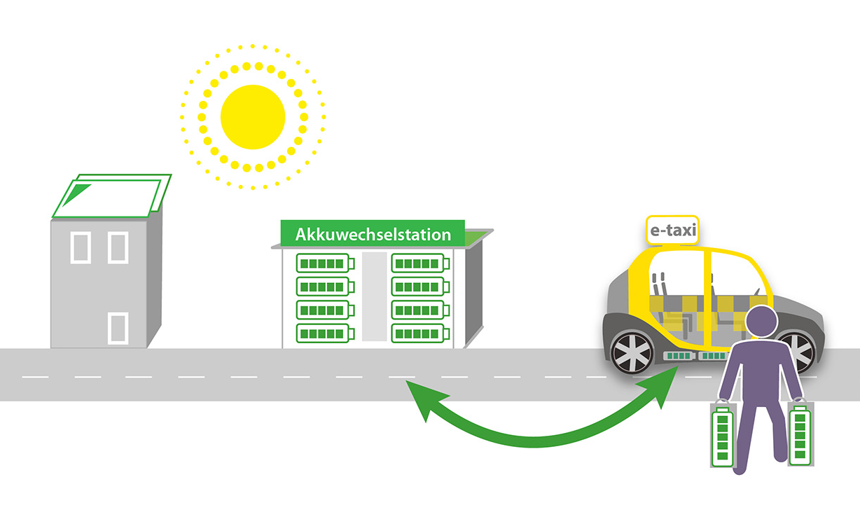
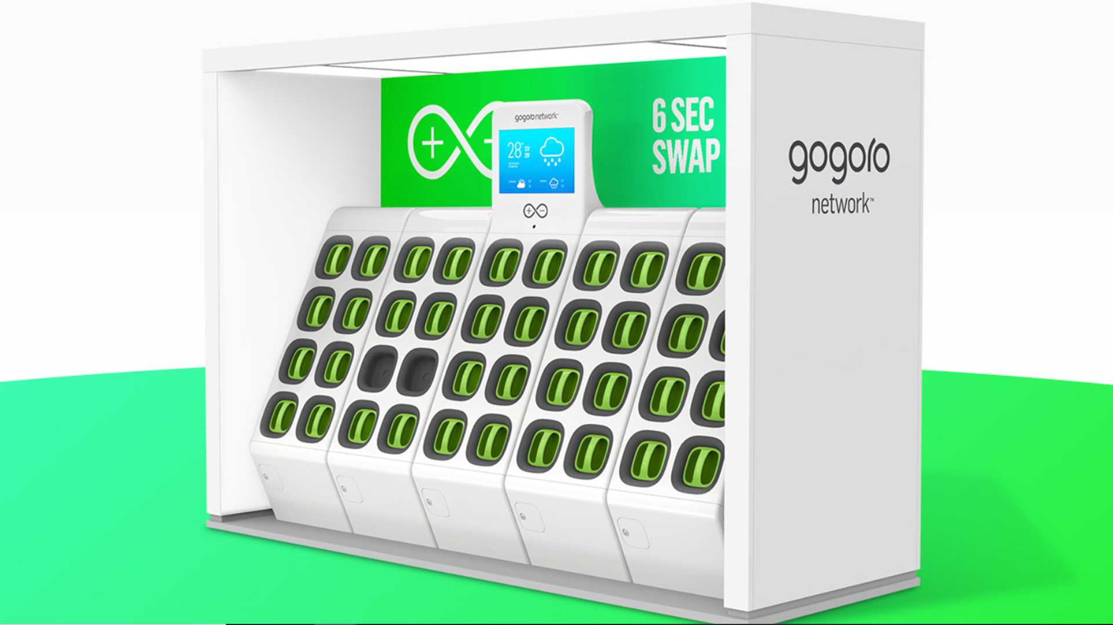
Battery Swapping
Based on premise of removing battery cost from the equation; another type of charging infrastructure is emerging called battery swapping.
It mimics the 5-10 min convenience of fuel filling as battery swap also takes a similar amount of time.
Battery swapping can also reduce range anxiety issue as it would convenient to get a charged battery at pre determined distance intervals.
IoT could be helpful in battery management system which will provide every information about the batteries used in swapping stations.
This model could be used for 2W, 3W and public transportation.

Slide 10
Other Technological Challenges
Charging Infrastructure
  Availability
  Type: AC,DC, Fast
  Standardisation of connector
  Connectivity with Green Grid.
Batteries
  Standardisation
  Battery Chemistry
  Indigenisation
  Disruptive Innovations

Slide 11
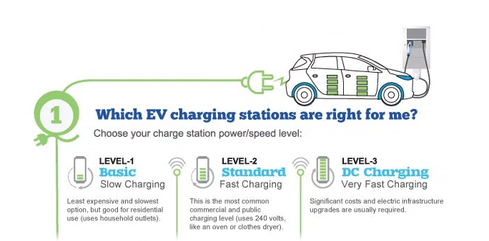
Charging Infrastructure-I
Biggest need of nation is to have charging stations across the length and breadth of the country to allow for easy adoption of electric vehicles.
Only 150 charging stations in India
Types of Chargers
  AC Slow Charger
  DC Fast Charger

Slide 12
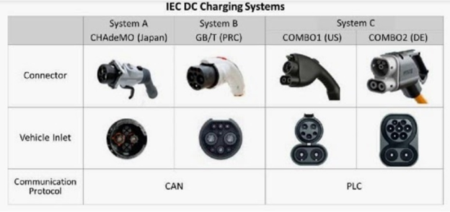
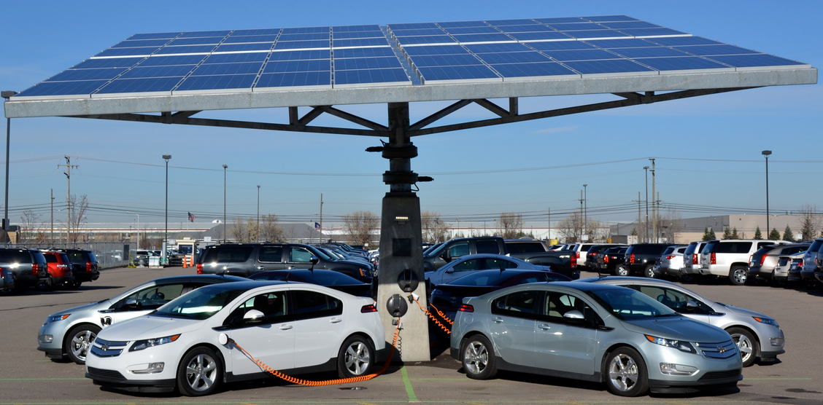
Charging Infrastructure-II
Standardisation of Charging Connector is also one of the major issue. There are many type of connectors are in the market and this needs to be standardised.
Connectivity with Green Grid or Green energy is also an issue.
In recent amendment in EV Policy:
  One charging station will be installed in a grid of 3Km* 3Km in cities
  Charging stations will be installed in every 25 Km on both sides of Highways
  Fast charging station in every 100 Km for intercity travel.

Slide 13
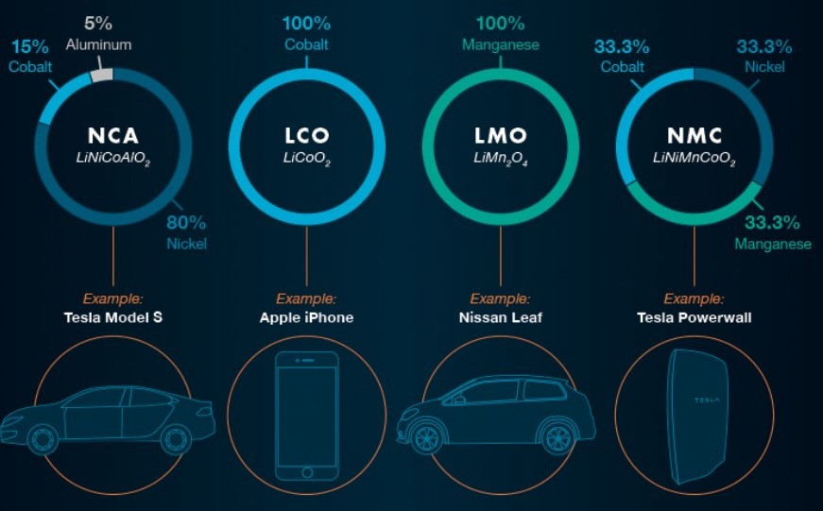
Batteries I
Batteries are not standardized in current EV market. Many players in the market however the standardisation is still lacking.
Battery Chemistry
  NCA- Nickel Cobalt Aluminum Oxide
  LCO- lithium cobalt oxide
  LMO- lithium Manganese oxide,
  NMC- Nickel Manganese Cobalt,

Slide 14
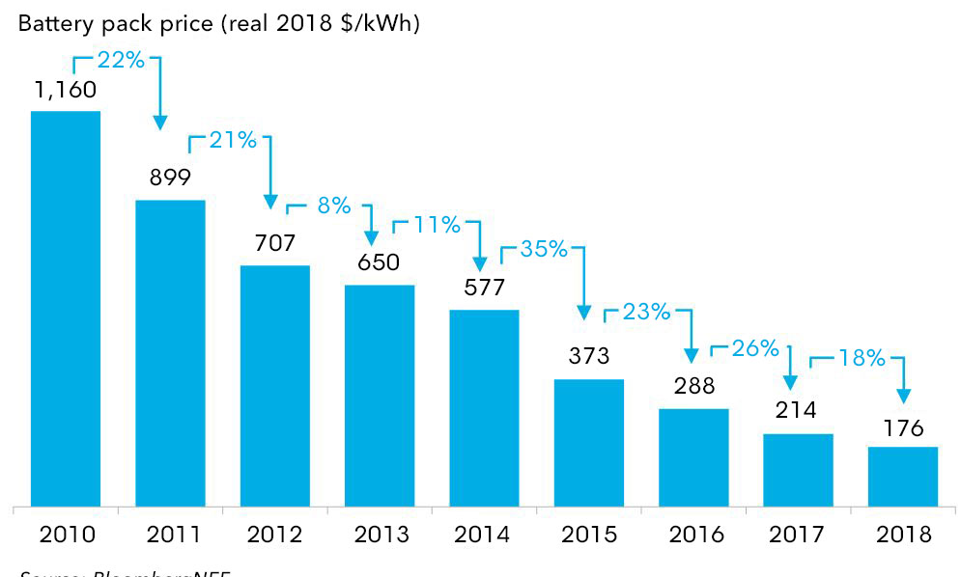
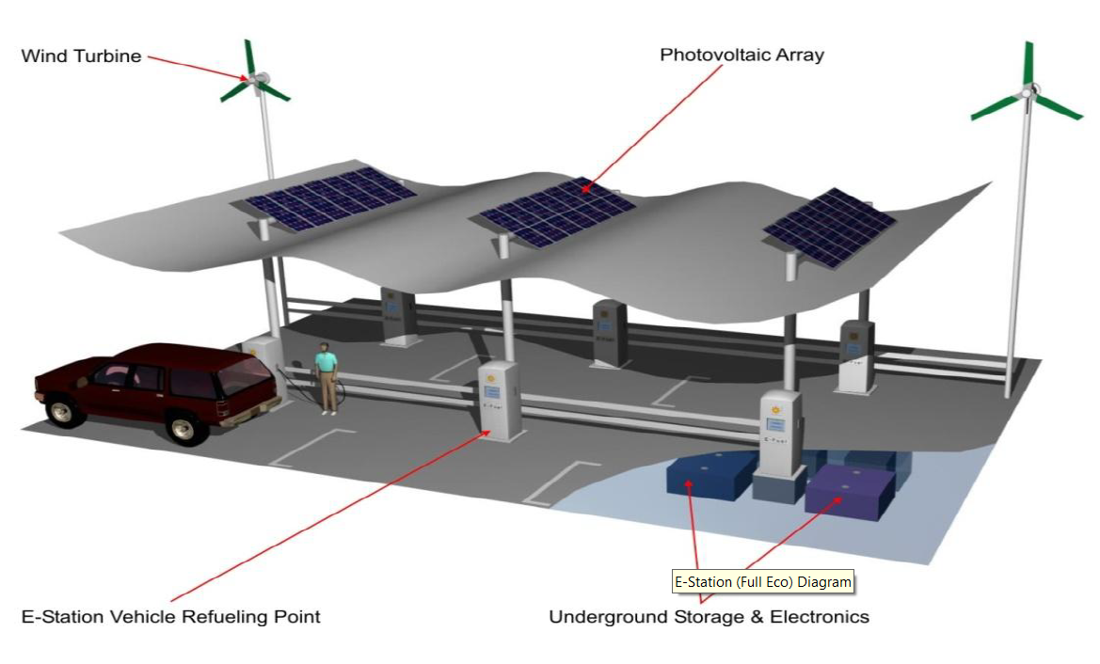
Batteries II
Availability of efficient batteries is also one of the major concern for Indian market
Currently Li-ion Batteries are being used in Electric Vehicles are largely imported. There is need for indigenous manufacturing of such batteries.
In Future there are possibility that the Li-ion batteries will be replaced by
  Flow Batteries
  Metal Air Batteries
  Good news is that the battery cost per kWh is steadily falling over last decade.

Slide 15
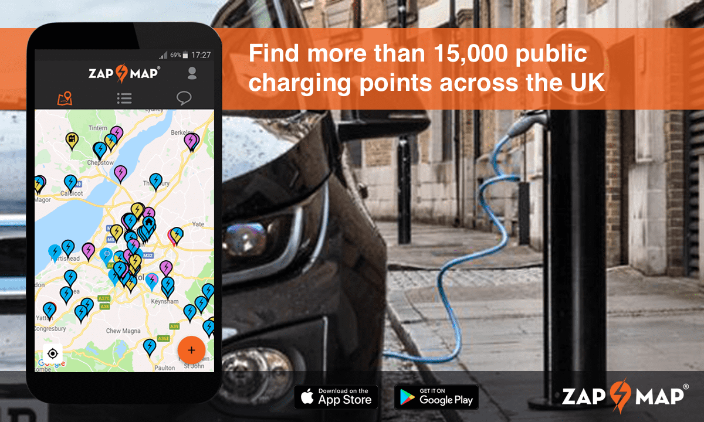
How to Mitigate these challenges
For Batteries
  Currently Li-ion is prevalent in market and the cost of battery is reducing every year. To cater the demand of batteries we need to import them from other countries.
  However if we do not produce locally and import too much then there is a threat of Electronic Components and Battery Import Bill exceeding the Petroleum Import Bill.
App Based Infra sharing
  Aggregator models for charging stations just like Ola, Uber etc.

Slide 16
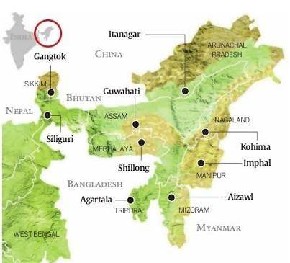
EV challenges and Potential for EV in Northeast India
Population Density in North Eastern state other than Assam is very less according to Census of India 2011.
Therefore, location and density of charging stations could be an issue.
Mostly hilly and mountainous terrain could lead to range issues.
However North-East India’s overall contributing to Two-wheeler sales in India is significant.
Public Transportation is a great necessity in this region.

Slide 17
Thank you
EVOracle
Ground Floor, 15 Vipul Agora
MG Road, Gurgaon
Email:pdiwan_2000@yahoo.com
www.evoracle.com

