Slide 1
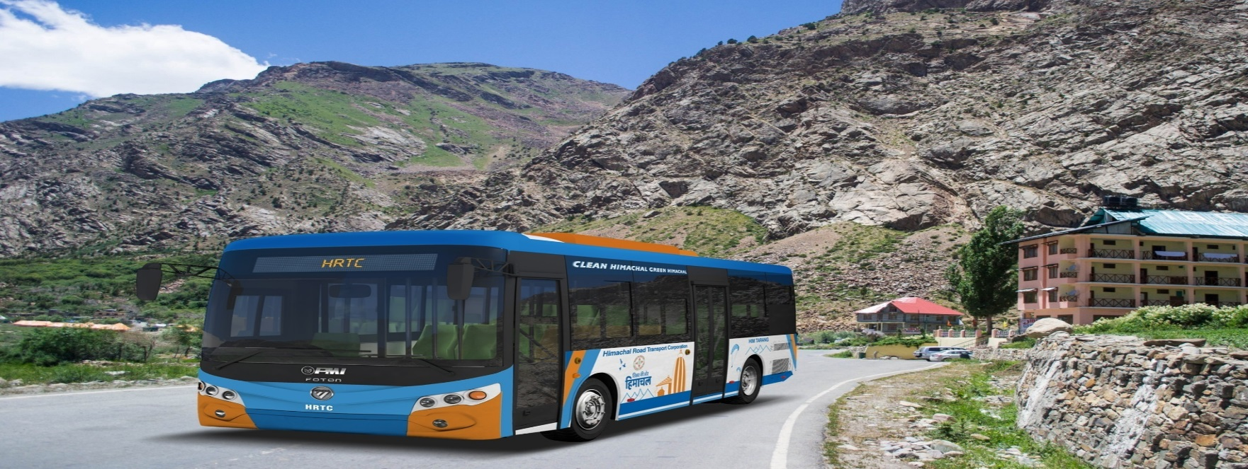
Business Model & Financing E- Bus Mobility
Workshop on
Electrification of Public Transport
Guwahati
Hemender Kumar Gupta
Chief General Manager
Himachal Road Transport Corporation

Slide 2
Financing Electric Buses
FAME I : Capex based Subsidy
Chief Ministers Bus Scheme in Gujarat : Operations based subsidy
FAME II : Need to fund 7000 buses (Around 10,000 crore)
Capex based subsidy, GCC mandatory
Model Concession Agreement by Niti Ayog
Tender document available on GeM
MAIN CAUSE OF CONCERN IS VERY HIGH COST OF EVs MAKING ALL BUSINESS MODEL FOR PROCUREMENT FINANCIAL UNSUSTAINABLE AND HENCE SUBSIDY DRIVEN .
What next, beyond subsidies?

Slide 3
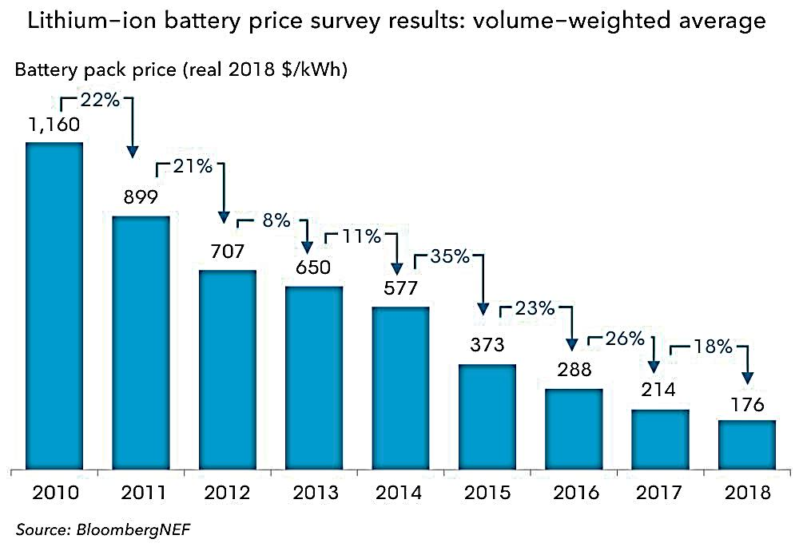
Vehicle | Fuel Econ. (Km/Kwh) | Range (km) | Battery (KWh) | Battery Cost (Rs. lakh)
2W | 20-24 | 80 | 4 | 0.72
3W | 16-18 | 70 | 4 | 0.72
Car | 4-5 | 150 | 36 | 6.50
Bus | 0.6 - 1 | 200 | 250 | 45.00
landed fitted costs in India around USD 250/ Kwh.

Slide 4
The actual costs for cells are subject to much debate and speculation as most EV manufacturers refuse to discuss this topic in detail.
However, in October 2015, car maker GM revealed at their annual Global Business Conference that they expected a price of US$145 per-kilowatt-hour for Li-ion cells entering 2016, substantially lower than other analyst's cost estimates. GM also expects a cost of US$100 per kwh by the end of 2021

Slide 5
Less understanding of EV Technology
Inadequate knowledge, information, experience about electric bus technology, operations, management is pushing prices higher .
Drive range issue and charging time is constant cause of concern.
Absence of Charging Infrastructure -Cost and time consumed for creating charging infrastructure is very high .
High Battery cost is stated to be main reason of higher prices (?) , Further Non discloser of cost of various components i.e. Motor and other Electronic controls .
FAME I and II makes a good beginning in terms of in introducing electric buses in India however Very high pricing of EV buses is making all business models (Capex/Opex) dependent on subsidies and thus scaling up in terms of number of cities and bus fleet in each city is on very slow pace.
Thus UBS – II need to be updated to include electric buses and Policy encouragement needs to be widened on the supplier side-OEM ,Energy supplier, Energy service provider, Bus operators etc and Local manufacturing base needs to be widened

Slide 6
EV is the need of hour, to avoid further degradation to our environment.
EVs are highly energy efficient , reliable ,practical with low operating /maintenance costs and thus these new energy vehicles are need of the hour.
Policy Framework needs further firming up
Faster Adoption and Manufacturing of Electric Vehicles (FAME) India, Phase I and II - for market development and manufacturing eco-system. More incentive needs to be given to larger passenger carrying capacity with least energy consumption.
Fiscal Incentives for EVs (GST, Concessions, Registration charge waiver etc) needs further strengthening
State Level Electric Vehicle (EV) policies
ERC – Concessional Tariffs etc.

Slide 7
WAY FORWARD
Key difference between E Buses and ICE Buses is higher capex need for E Buses and these prices needs to be debated component wise to get the optimum price of EV and its eco system.
STUs/Operators need to be financially strengthened to create capacity to purchase buses through borrowing on their own strengths, rather than depending on ad hoc subsidies
The need is financing of Public Transport system , not Electric Vehicles.
Karnataka Electric Vehicles & Electric Storage Policy 2017

Slide 8
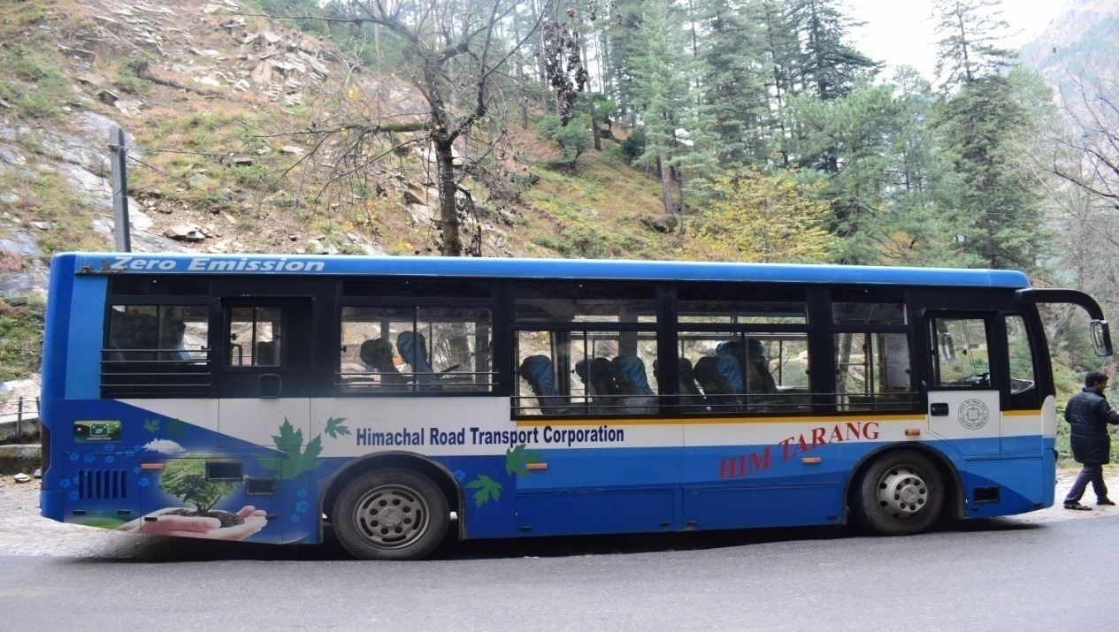
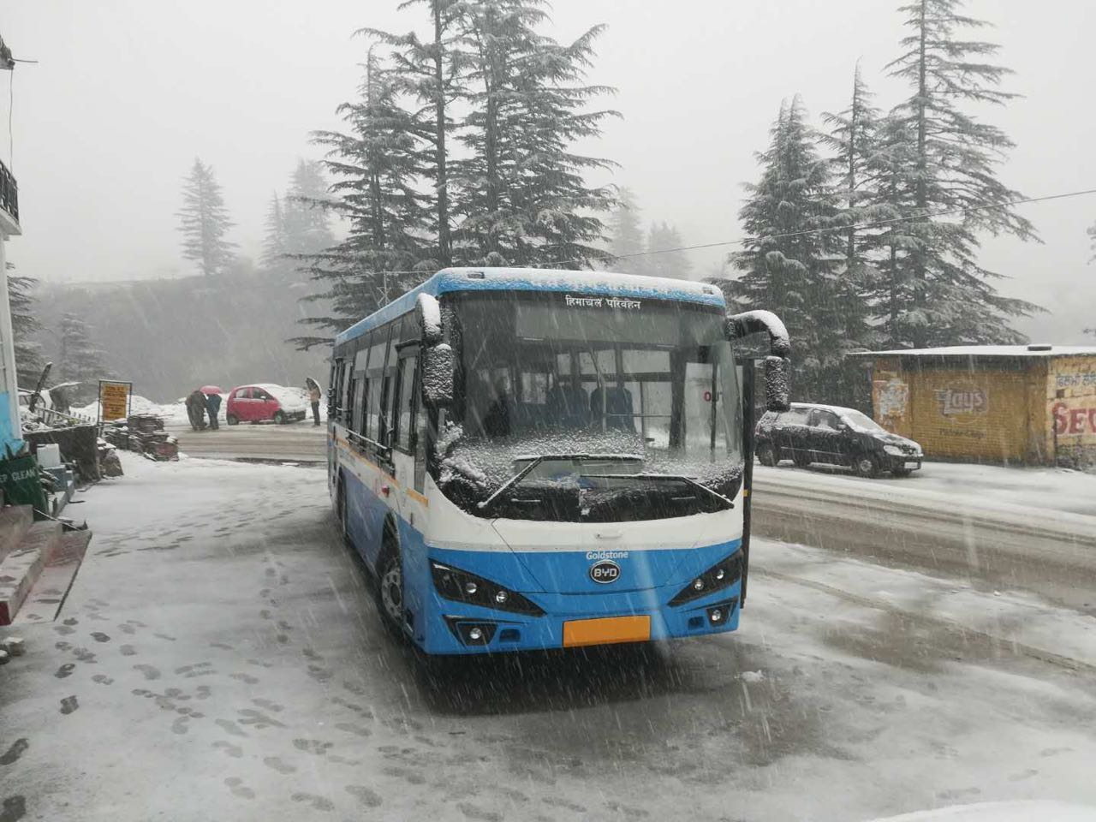
Himachal Road Transport Corporation
Commercial Operation of Electric Buses in Himachal Pradesh started in 2017with branding as
“Him Tarang” and these 25 e buses are operating in Kullu Manali.

Slide 9
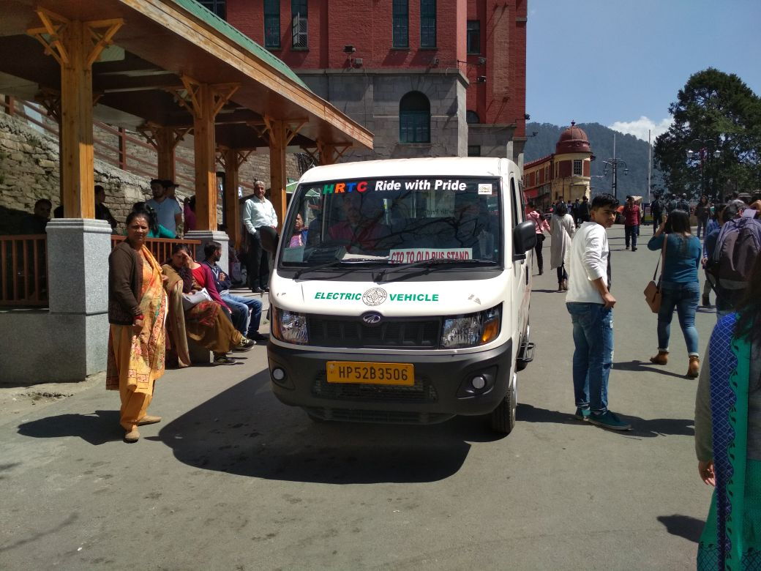
For improving End to end connectivity
These 50 electric taxis (7 +D) are being plied successfully in important tourist destination i.e. Shimla,Chamba, Nahan, Dharamshala, Palampur , Nagrota, Kullu, Sundernagar, Bilaspur, Hamirpur, Una ,Solan, Rampur and Keylong towns. These taxis are noiseless and pollution free. These taxis are providing best transport facilities to the passengers in the state. Each Electric taxi is covering approximately 60-70 Kms per day .

Slide 10
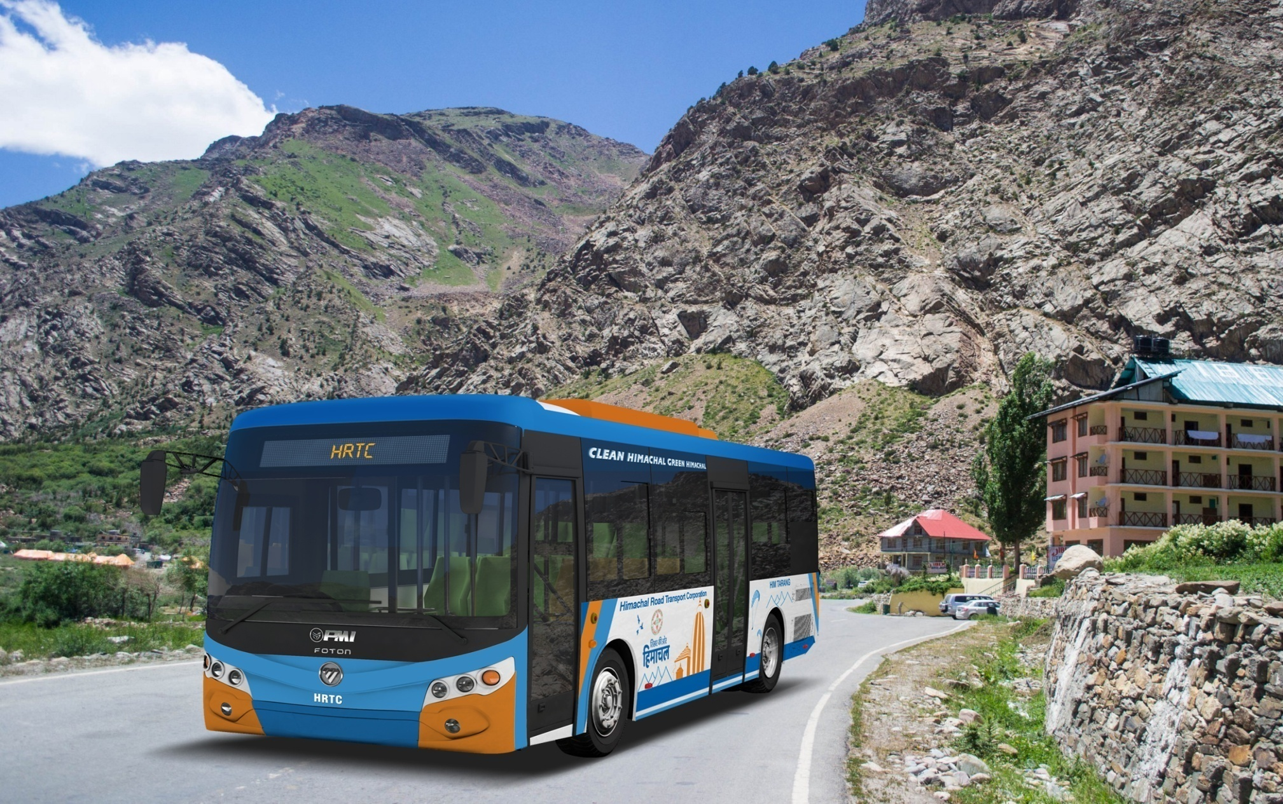
50 electric buses are operating in and around Shimla since March 2019

Slide 11
Himachal Road Transport Corporation
QUESTIONS
&
ANSWERS
Thank You

