Slide 1
North East Electric Conclave

Slide 2




Slide 3


Slide 4



Slide 5




Slide 6



Slide 7
Kindly spare a thought for this humble two wheeler too

Slide 8


Slide 9


Slide 10
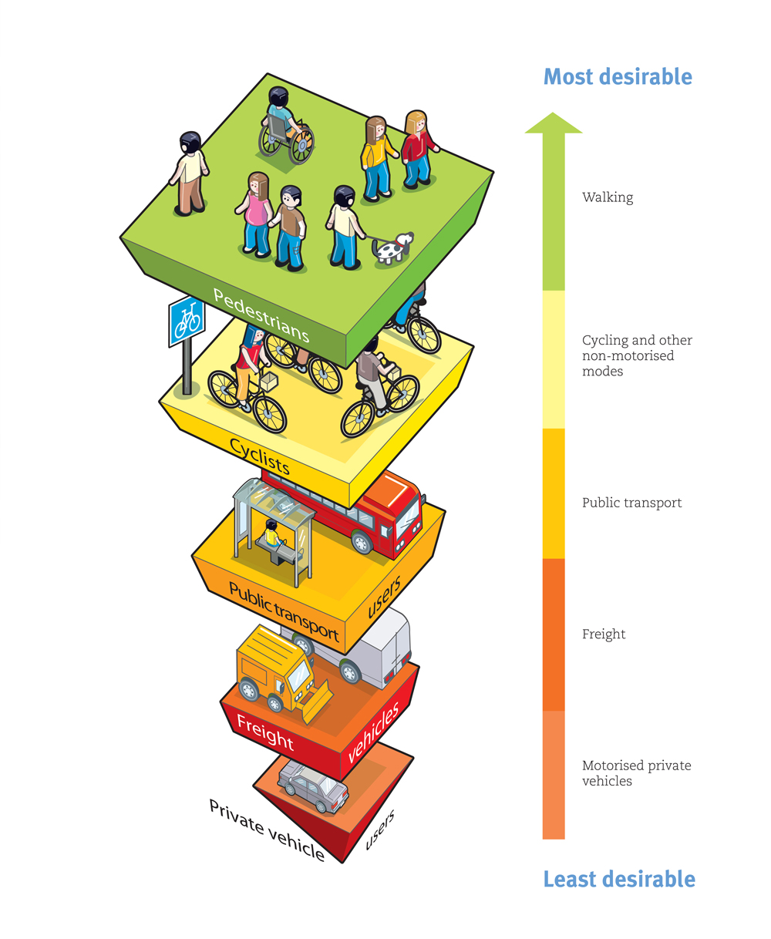

Slide 11


Slide 12


Slide 13
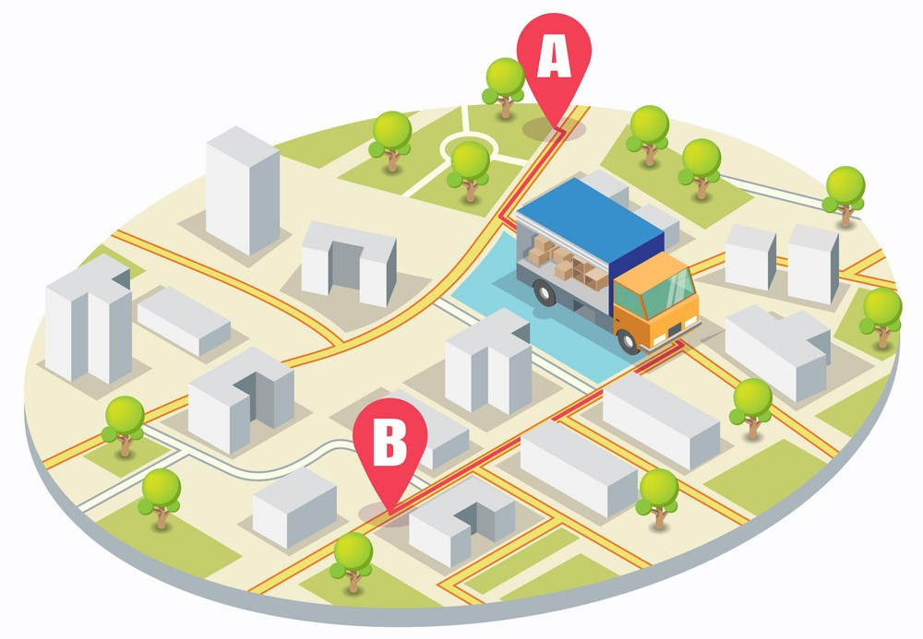

Slide 14
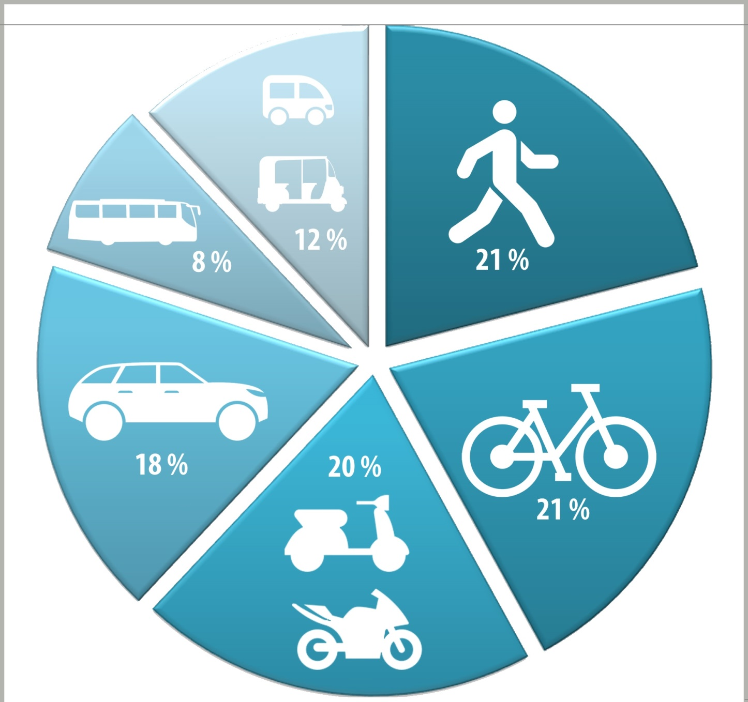
Modal Share

Slide 15
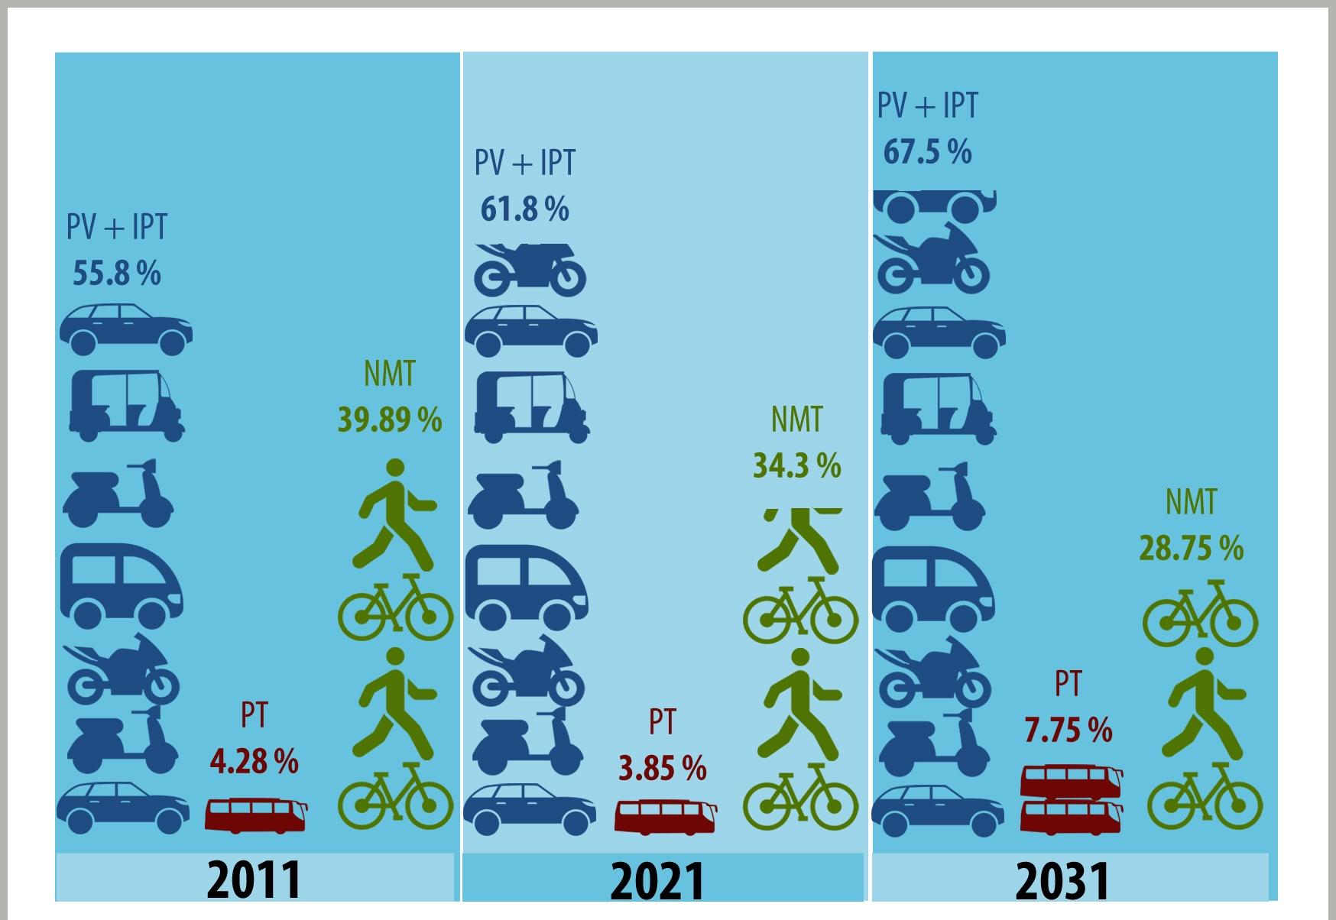
Travel Demand Forecast

Slide 16
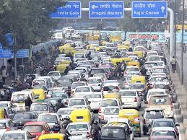

Slide 17


Slide 18
History
The first E-Cycle was invented in the 1890s in US
In India the first E-Cycles appeared in 1993

Slide 19
Legal Definition of E-Cycles in India
One or more electric motor with power of less then 250W
Maximum speed of 25 KMs per hour
Electric Vehicles, which comply with the above requirements are not categorized as motor vehicles. Hence the transport rules are not applicable for them (Insurance, taxes, helmet, driving license, pollution certificate, etc)

Slide 20
Classification of E-Cycles
E-cycles with pedal-assist only also called pedelecs
E-cycles with power-on-demand only:
E-cycles with power-on-demand and pedal-assist

Slide 21
Advantages of E-Cycles

Slide 22
Support Required

Slide 23
Thank You

